Slide 1
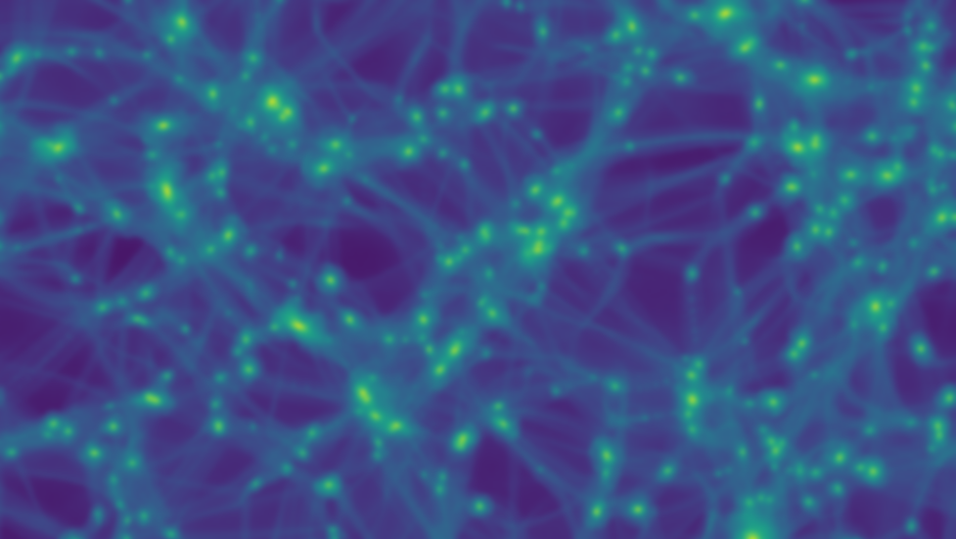
Probing cosmology using dark matter microhalos
M. Sten Delos
University of North Carolina at Chapel Hill
Talk prepared for the Perimeter Institute
February 6, 2020

Slide 2
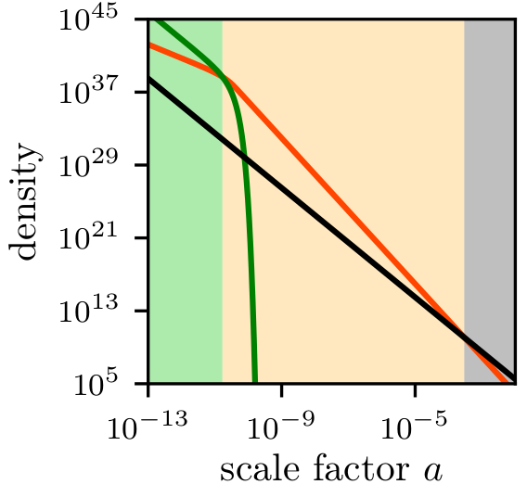
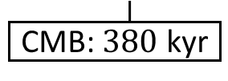
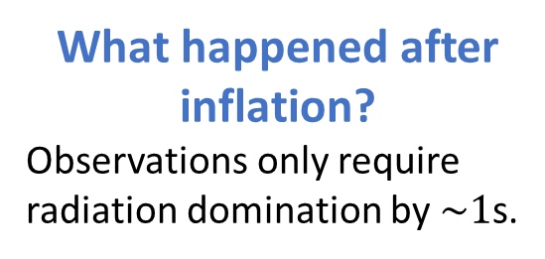
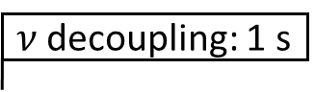
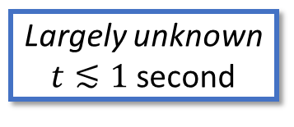
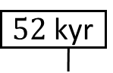
Three questions in cosmology
Largely unknown
$t≲1$ second
$ν$ decoupling: 1 s
$52$ kyr
Galaxies & stars
Matter
Dark energy
Inflation?
???
Radiation
Opaque
CMB: $380$ kyr
Today
Inflation is invoked to solve horizon & flatness problems and seed density variations. But…
What drove inflation?
(Or alternative process)
What happened after inflation?
Observations only require radiation domination by $\sim 1$s.
Most matter is nonbaryonic dark matter.
What is dark matter?
Radiation
Early matter domination?
Moduli fields
Hidden-sector mediator
Inflaton
[Must decay into radiation by 1s]
Early matter
Matter

Slide 3
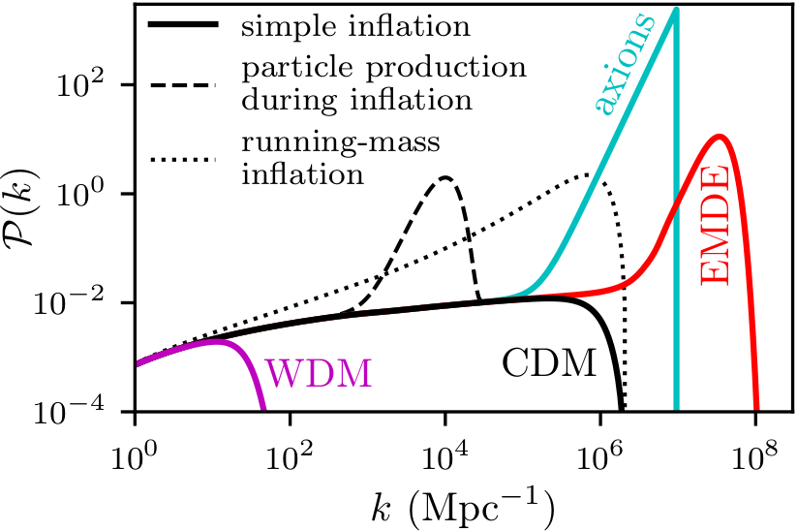
Signatures in the (linear) matter power spectrum
What happened after inflation?
Early matter domination boosts density variations.
[Early matter species clusters, carrying DM with it]
What drove inflation?
Dynamics of the inflaton field imprint on the primordial power spectrum.
What is dark matter?
Free-streaming (CDM vs WDM)
Poisson noise (axion, PBH)

Slide 4
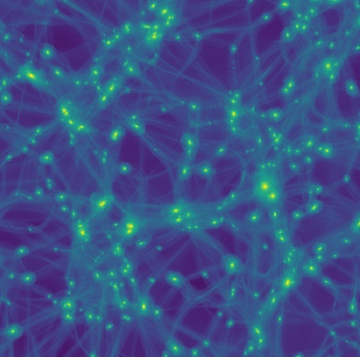
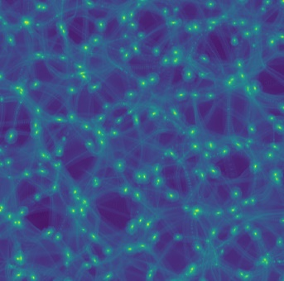
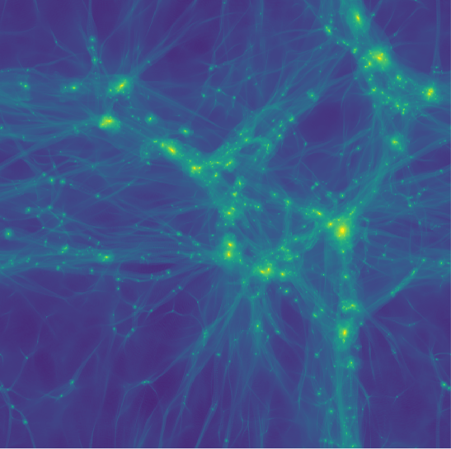


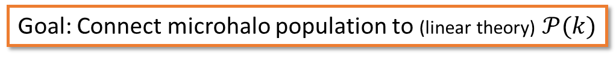
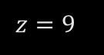
Dark matter microhalos
1 pc
EMDE
The first dark matter halos are a powerful probe of subkiloparsec-scale density variations.
$$z=100$$
The theoretical challenge:
Nonperturbative dynamics: must use simulations
Microhalos are too small and dense to simulate in full context
We require (semi)analytic modeling.
Goal: Connect microhalo population to (linear theory) $𝒫(k)$
$$z=50$$
$$z=9$$
Inflationary bump
CDM
4 kpc
150 pc

Slide 5
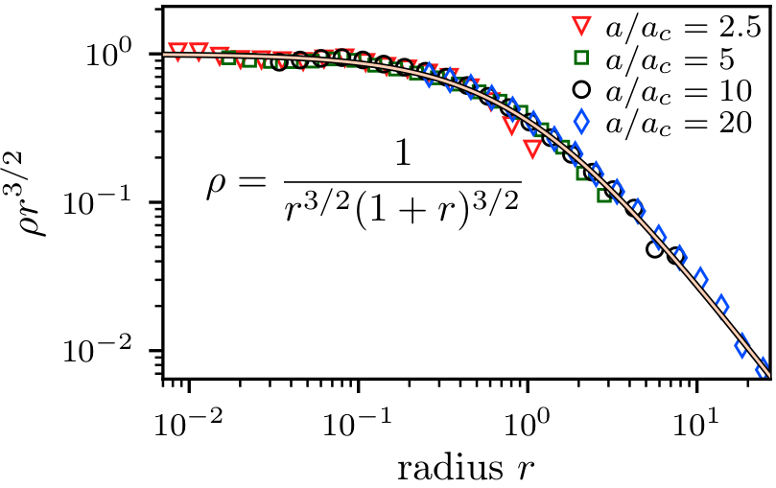
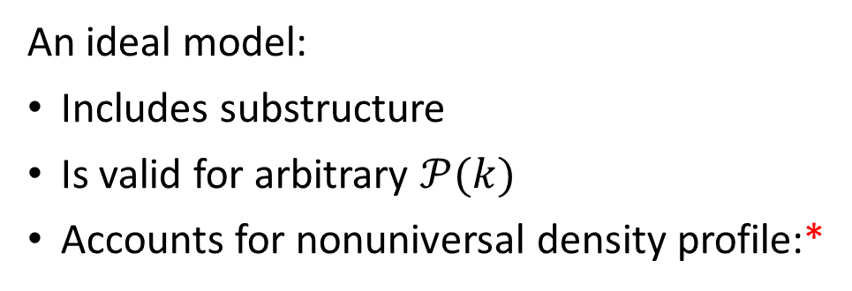
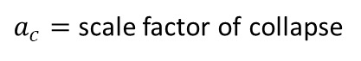
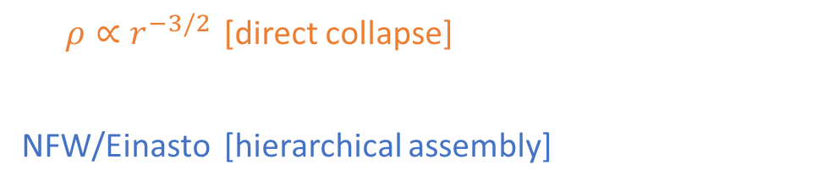
Modeling dark matter structure
Simulating the density profiles of the first halos
Ishiyama, Makino, Ebisuzaki 2010 [arXiv:1006.3392]
Anderhalden & Diemand 2013 [arXiv:1302.0003]
Ishiyama 2014 [arXiv:1404.1650]
Polisensky & Ricotti 2015 [arXiv:1504.02126]
Ogiya, Nagai, Ishiyama 2016 [arXiv:1604.02866]
Angulo, Hahn, Ludlow, Bonoli 2017 [arXiv:1604.03131]
Ogiya & Hahn 2018 [arXiv:1707.07693]
Gosenca, Adamek, Byrnes, Hotchkiss 2017 [arXiv:1710.02055]
Delos, Erickcek, Bailey, Alvarez 2018a [arXiv:1712.05421]
Delos, Erickcek, Bailey, Alvarez 2018b [arXiv:1806.07389]
Delos, Bruff, Erickcek 2019 [arXiv:1905.05766]
Ishiyama & Ando 2020 [arXiv:1907.03642]
An ideal model:
Includes substructure
Is valid for arbitrary $𝒫(k)$
Accounts for nonuniversal density profile:*
Standard Press-Schechter
Concentration-mass relations
$ρ∝r^{−3/2}$ [direct collapse]
NFW/Einasto [hierarchical assembly]
The first halos
Later-generation halos
$ρ∝r^{−9/4}$ [uncompensated overdensity, e.g., PBH]
$a_{c}=$ scale factor of collapse
Does not arise from Gaussian random field

Slide 6
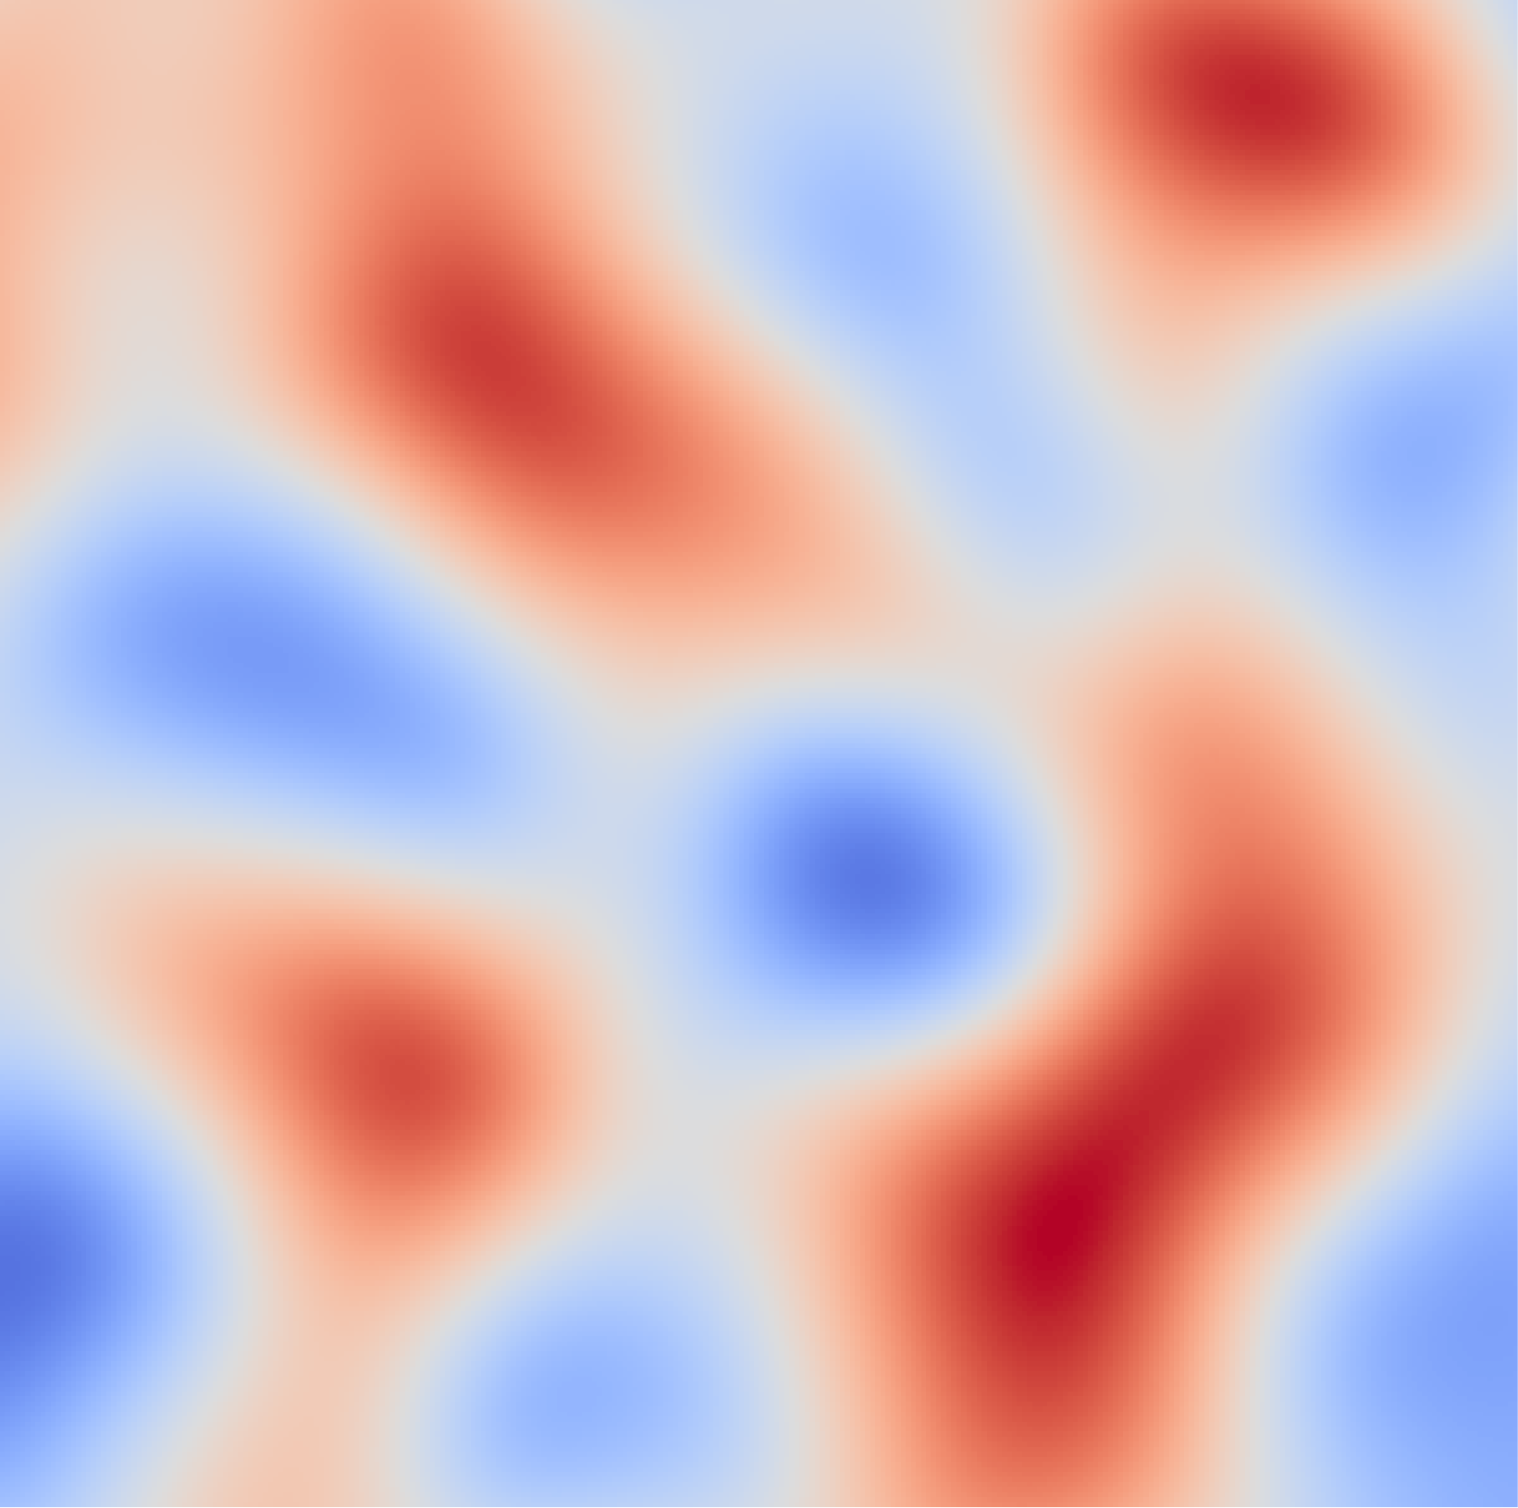
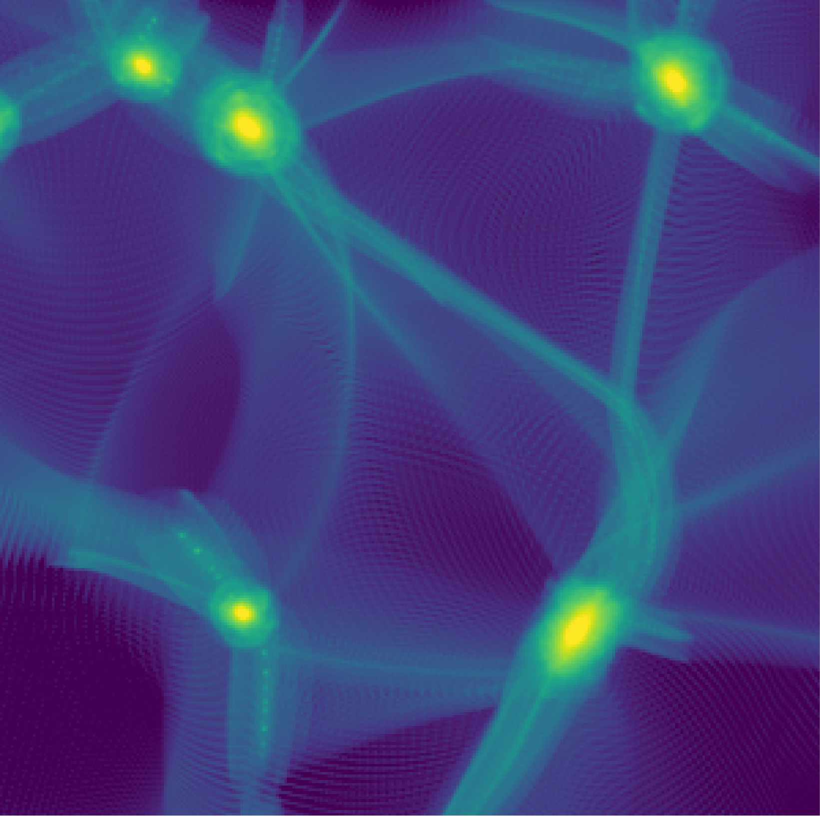
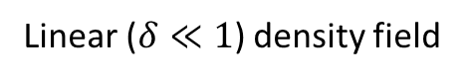
(Micro)halos from density peaks
When studying the first (and smallest) halos, it is natural to consider the unfiltered density field.
[Contrast with Press-Schechter. Free-streaming cutoff tames divergence in $σ$.]
Associate each peak in the density field with a collapsed halo:
Linear ($δ≪1$) density field
Nonlinear structure

Slide 7
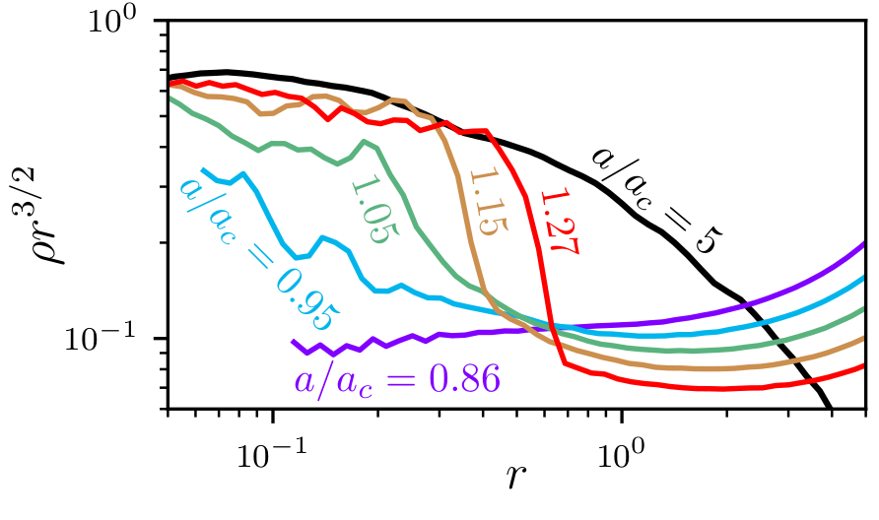
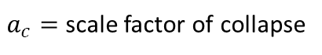
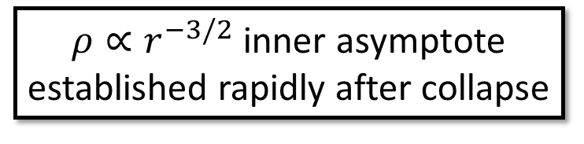
Formation and growth of the first halos
$ρ∝r^{−3/2}$ inner asymptote established rapidly after collapse
Transition to steeper outer profile as accretion slows
$a_{c}=$ scale factor of collapse

Slide 8
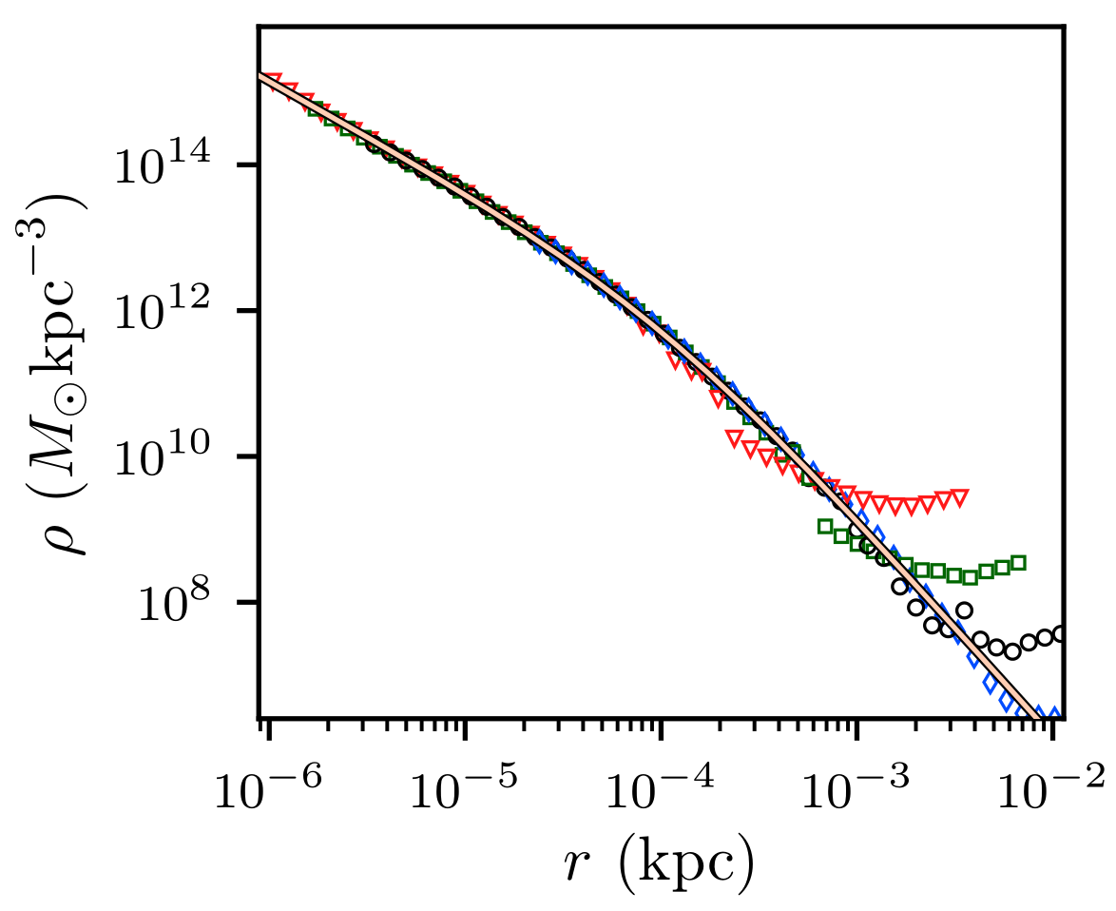
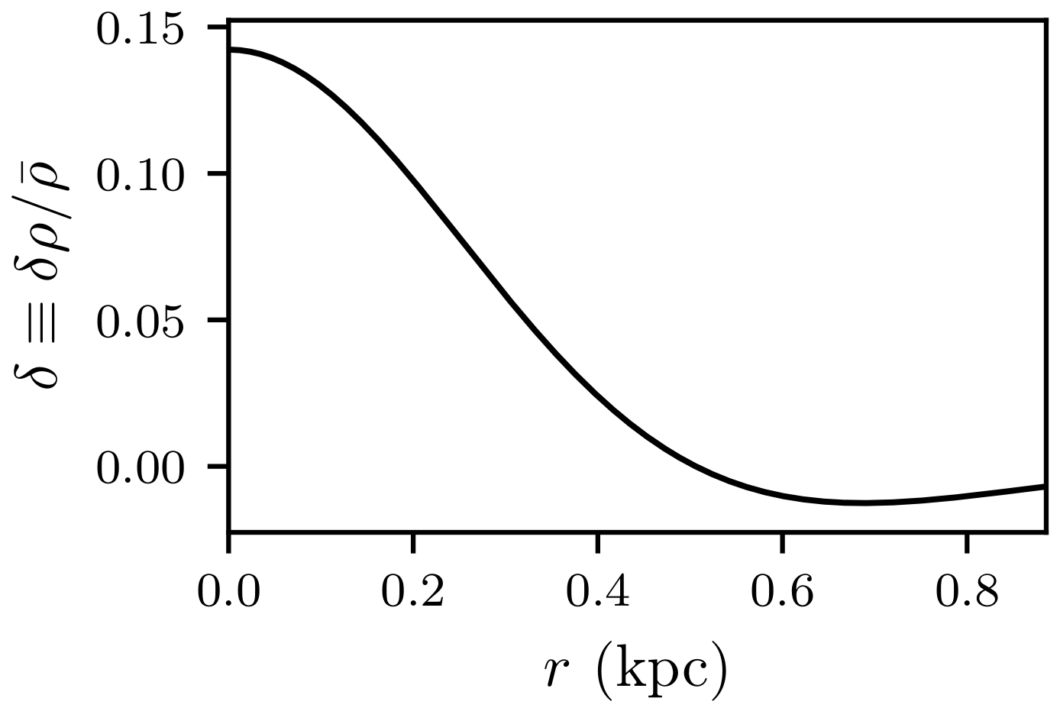
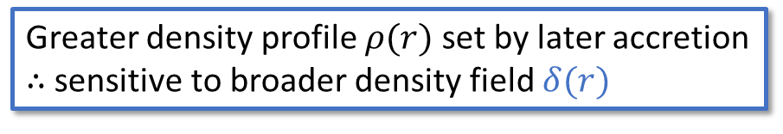
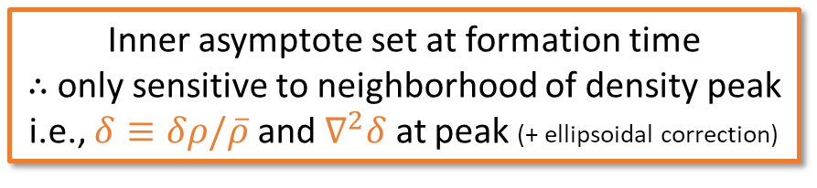
Halo structure from peak structure
Inner asymptote set at formation time
∴ only sensitive to neighborhood of density peak
i.e., $δ≡δρ/\overline{ρ}$ and $∇^{2}δ$ at peak (+ ellipsoidal correction)
Collapsed halo
Density peak
Greater density profile $ρ(r)$ set by later accretion
∴ sensitive to broader density field $δ(r)$
Slow accretion → use a secondary infall model
Gunn & Gott 1972; Gott 1975; Gunn 1977; Fillmore & Goldreich 1984; Bertschinger 1985; Hoffman & Shaham 1985; Ryden & Gunn 1987;
White & Zaritsky 1992; Zaroubi & Hoffman 1993; Lokas & Hoffman 2000; Nusser 2001; Ascasibar, Yepes, Gottlöber, Müller 2004;
Lu, Mo, Katz, Weinberg 2006; Ascasibar, Hoffman, Gottlöber 2007; Zukin & Bertschinger 2010a,b; Dalal, Lithwick, Kuhlen 2010

Slide 9
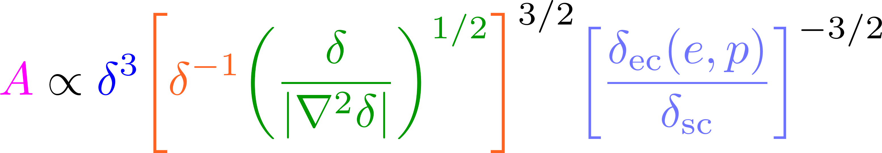
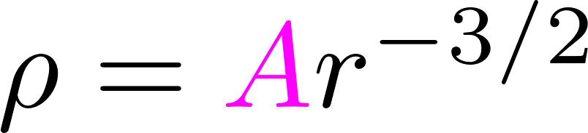
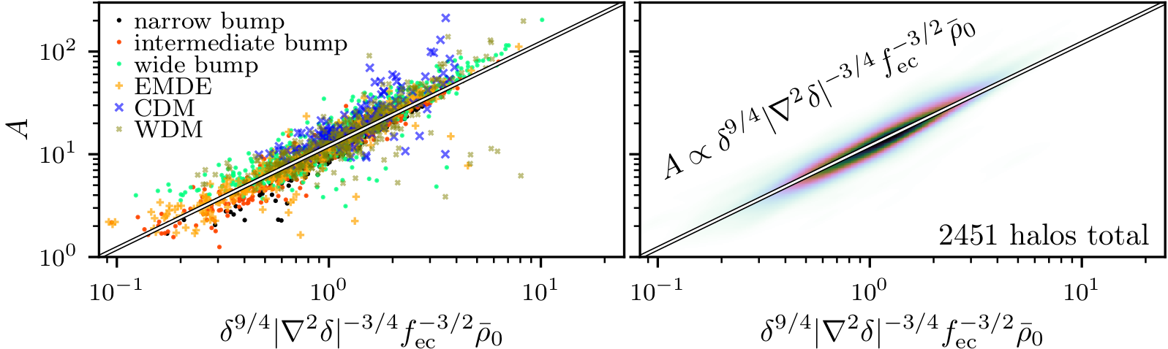
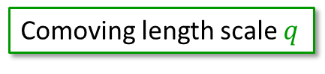
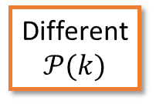
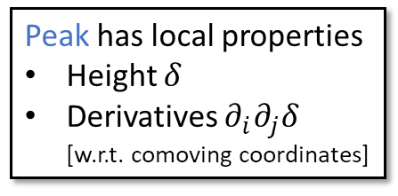
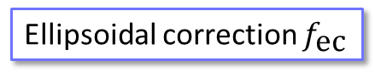
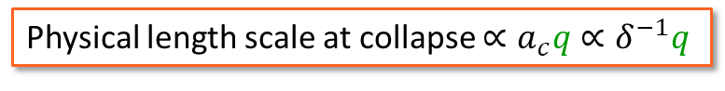
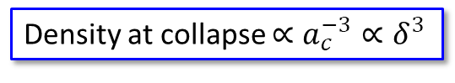
Inner asymptote from peak structure
Peak has local properties
Height $δ$
Derivatives $∂_{i}∂_{j}δ$ [w.r.t. comoving coordinates]
Physical length scale at collapse $∝a_{c}q∝δ^{−1}q$
Ellipsoidal correction $f_{\text{ec}}$
The connection:
Halo has:
Density at collapse $∝a_{c}^{−3}∝δ^{3}$
Comoving length scale $q$
Different
$$𝒫(k)$$
Arbitrary units; simulations scaled to fit on the same plot
More detail: Delos, Bruff, Erickcek 2019 [arXiv:1905.05766]

Slide 10

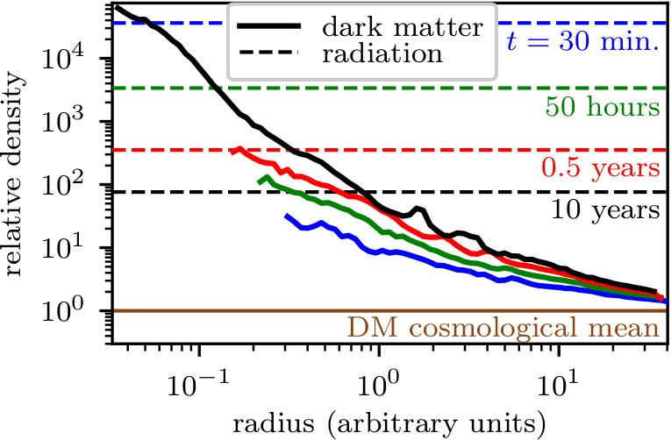
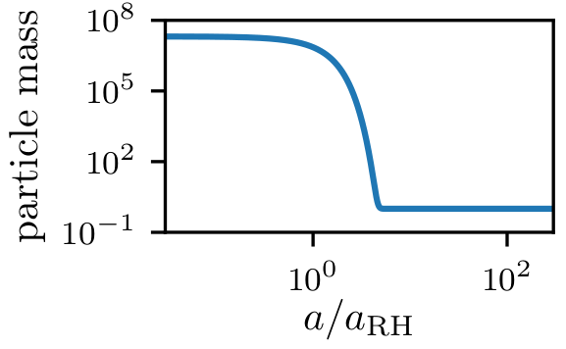

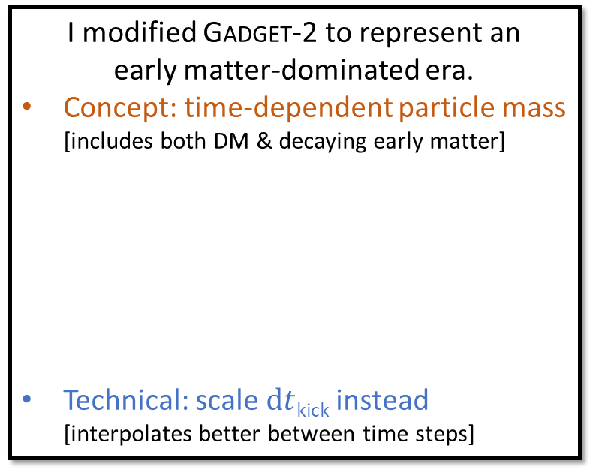
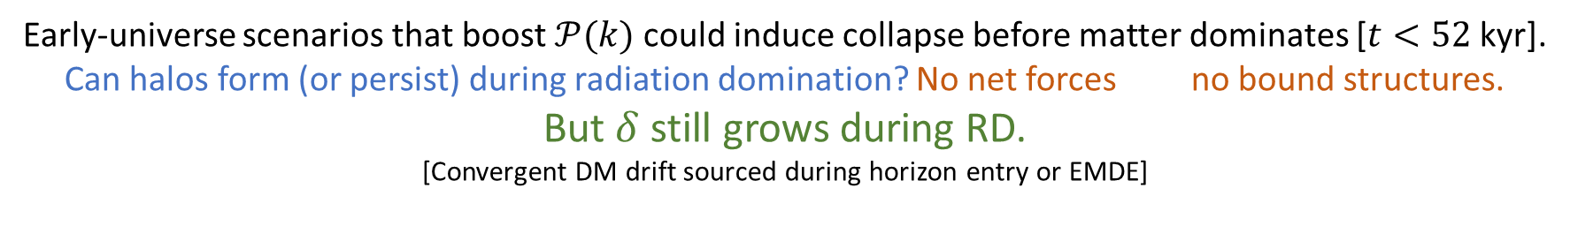
Halo formation prior to matter domination
Early-universe scenarios that boost $𝒫(k)$ could induce collapse before matter dominates [$t<52$ kyr].
Can halos form (or persist) during radiation domination? No net forces no bound structures.
But $δ$ still grows during RD.
[Convergent DM drift sourced during horizon entry or EMDE]
I modified Gadget-2 to represent an early matter-dominated era.
Concept: time-dependent particle mass [includes both DM & decaying early matter]
Technical: scale $\text{d}t$_{kick} instead [interpolates better between time steps]
Collapsed (but not bound)
Local $ρ$_{DM} $>ρ$_{rad}
Bound halo forms!
More detail: Blanco, Delos, Erickcek, Hooper 2019 [arXiv:1906.00010]

Slide 11

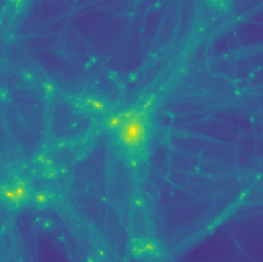
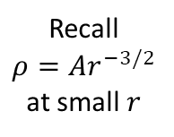
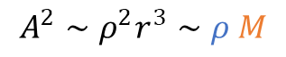
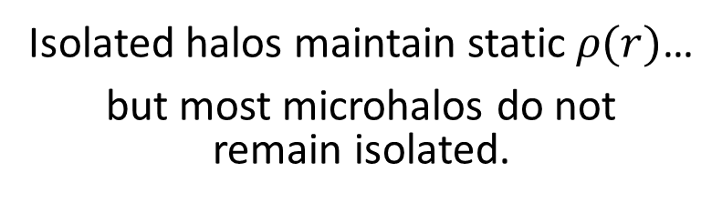
Halo evolution
Isolated halos maintain static $ρ(r)$…
but most microhalos do not remain isolated.
Microhalo-microhalo mergers:
a topic of future research.
Approximately,
Recall $$ρ=Ar^{−3/2}$$ at small $r$
Mass additive in mergers (approx.)
Conceptually:
$$A^{2}∼ρ^{2}r^{3}∼ρ M$$
Characteristic density preserved (approx.)
[e.g., Drakos et al. 2019]
Useful because DM annihilation rate $∝A^{2}$
Can we understand how microhalos structurally evolve as they merge to produce larger objects?
Accretion onto larger (e.g., galactic) halos:
Subhalo evolution.
Tidal forces
Encounters with other objects

Slide 12
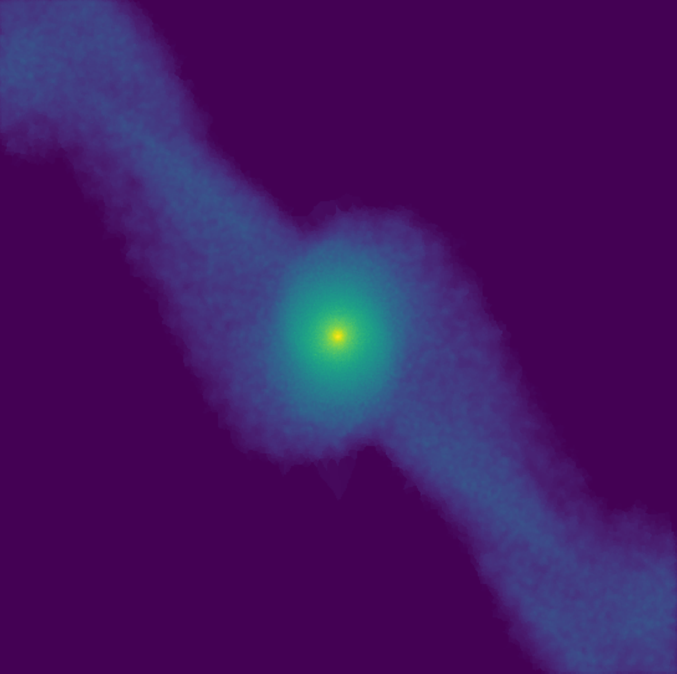
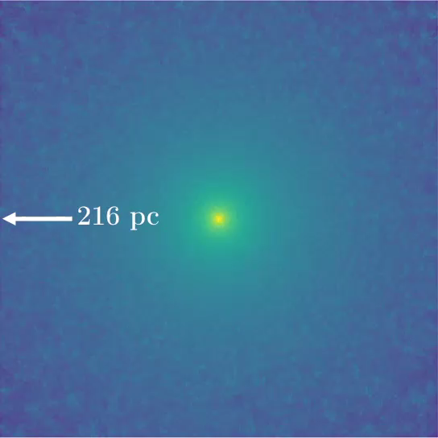
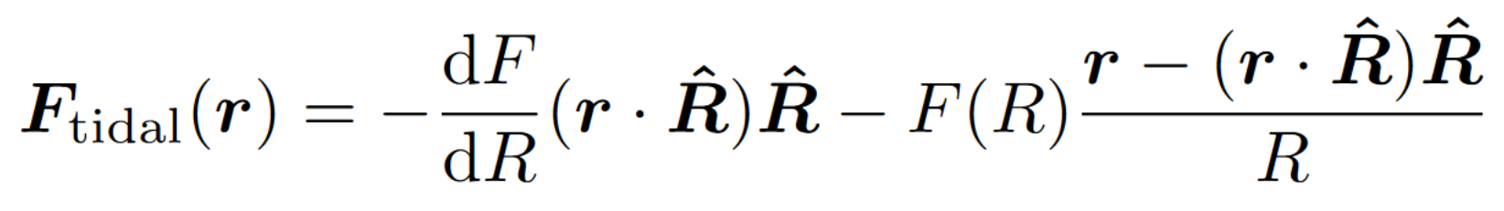
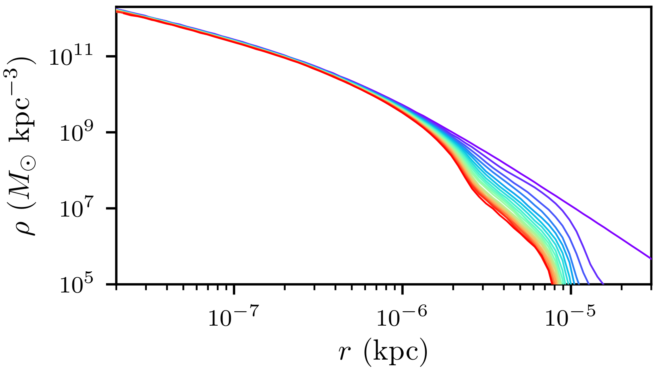

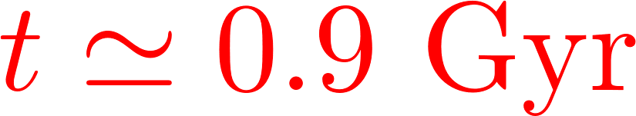
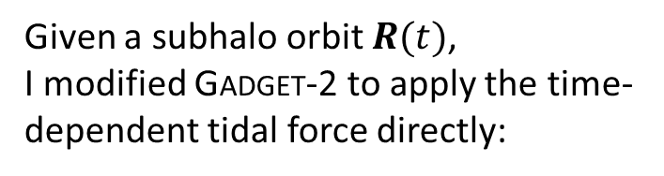
Tidal evolution
$N$-body microhalo orbiting analytic dSph
Given a subhalo orbit $R(t)$,
I modified Gadget-2 to apply the time-dependent tidal force directly:
[Evades numerical artifacts associated with scale disparity between orbital and internal dynamics.]
0.03 pc
Central cusp persists
Arrow to host center
More detail: Delos 2019a [arXiv:1906.10690]

Slide 13









Host-subhalo system
Parameters:
Subhalo size $r_{s}$
Subhalo density $ρ_{s}$
Host size $R_{s}$
Host density $P_{s}$
Orbit radius $R_{c}$
Orbit shape $η$
Time $t$
Better parametrization:
$$\frac{ΔE_{imp}}{\left|E_{b}\right|}$$
Relative energy injection per orbit [impulse approx.]
Sets direction of tidal forces
$${\overline{R}/R}_{s}$$
vs
$\overline{R}≳R_{s}$ $\overline{R}≪R_{s}$
Orbit shape
timescale for tidal forces
tidal heating distribution
subhalo density profile
Minimal:
$$ρ_{s}/P_{s}$$
$$R_{c}/R_{s}$$
$$η$$
$$t/\sqrt{R_{c}/F(R_{c})}$$
tidal
$$r_{a}/r_{t}$$
adiabatic shielding
$$t/T$$
Orbit count
More detail: Delos 2019a [arXiv:1906.10690]

Slide 14








Modeling tidal evolution
[Story is similar for other subhalo properties]
Focus on the dark matter annihilation rate $∝$ .
Evolution satisfies:
More circular
Coefficient $b$ depends on
$ΔE_{imp}/\left|E_{b}\right|$ [energy injection per orbit]
${\overline{R}/R}_{s}$ [direction of tidal forces]
More radial
Factor related to change in density profile shape;
index $c$ depends on $r_{a}/r_{t}$ [tidal heating distribution]
Fixed by overall scale:
More circular: tidal efficiency drops as outskirts stripped
Compression/stretching; depends on ${\overline{R}/R}_{s}$ and $ΔE_{imp}/\left|E_{b}\right|$ [tidal force direction and strength]
More detail: Delos 2019a [arXiv:1906.10690]

Slide 15




Stellar encounters
$N$-body microhalo encountering a series of stars
I modified Gadget-2 to apply $Δ\vec{v}$ induced by a series of stellar encounters…
…and developed an accurate
predictive model:
0.06 pc
1305 encounters
in total
More detail: Delos 2019b [arXiv:1907.13133]

Slide 16






Application: Breaking a dark degeneracy
An early matter-dominated era (EMDE) broadens the range of viable parameters for thermal-relic dark matter. [Decay sources radiation that dilutes DM → need more DM → smaller $\left\langle σv\right\rangle$.]
Fermi 2015 (dSphs)
DM free-streaming
(relative to reheat)
EMDE also boosts density variations:
Isotropic $γ$ ray background,
Reheat temp. (end of EMDE)
Early, highly dense microhalos
Improved indirect-detection bounds
More detail: Delos, Linden, Erickcek 2019 [arXiv:1910.08553]

Slide 17


Application: Breaking a dark degeneracy
Annihilation signal from microhalos resembles DM decay.
Microhalo distribution $\sim$ DM distribution
Galactic systems can discriminate.
Disruption of microhalos by tidal forces & stellar encounters
Differential microhalo suppression
Unique annihilation signal morphology:
No suppression [DM decay]
DM decay vs microhalo annihilation
Different DM & EMDE parameters
More detail: Delos, Linden, Erickcek 2019 [arXiv:1910.08553]

Slide 18


Application: The primordial power spectrum
Constraints on superhorizon curvature fluctuations (sourced by inflation):
Microhalos are the strongest probes of $𝒫_{ζ}(k)$ at subkpc scales
Assumes DM model.
I plan to also consider gravitational signatures: pulsar timing & lensed stars
Black = perturbative calculation
Color = nonlinear structure
More detail: Delos, Erickcek, Bailey, Alvarez 2018b [arXiv:1806.07389]

Slide 19


Summary: Microhalos as cosmological probes
Key cosmological questions
What drove inflation?
What happened after inflation?
What is dark matter?
are connected to the small-scale (linear) matter power spectrum.
Subhalo evolution models
Tidal evolution
Stellar encounters
Peak-to-halo model
Predicts the density profiles of the first (micro)halos
Predict microhalo evolution after accretion onto larger systems
Applications I have explored:
Constraints on thermal-relic dark matter that account for our ignorance of the early cosmic history
Constraining the small-scale primordial power spectrum
My research connects $𝓟(k)$ to microhalos today, looking toward observational signatures
Accurate for arbitrary $𝒫\left(k\right)$

Slide 20




Supplemental Greater density profile from peak structure
Connect halo’s mass profile $M\left(r\right)$ to peak’s mass-contrast profile $Δ(q)$
using a spherical infall model:
Simplest model:
Good approximation only for slow accretion (large radii)
Hubble flow
Freeze shell at fraction of turnaround radius
Refinements, e.g., adiabatic contraction:
Collapsing shell
Models not new, but application is.
More detail: Delos, Bruff, Erickcek 2019 [arXiv:1905.05766]

Slide 21






Supplemental Modeling stellar encounters
Universal postencounter density profile
Encounter with
causes:
Other variables
$b/r_{s}$ (relative impact parameter)
$t_{dyn}/(b/V)$ (“impulsiveness”)
typically $≫1$ irrelevant
More detail: Delos 2019b [arXiv:1907.13133]

Slide 22





Supplemental Note on universality
Simulating the density profiles of the first halos
Ishiyama, Makino, Ebisuzaki 2010 [arXiv:1006.3392]
Anderhalden & Diemand 2013 [arXiv:1302.0003]
Ishiyama 2014 [arXiv:1404.1650]
Polisensky & Ricotti 2015 [arXiv:1504.02126]
Ogiya, Nagai, Ishiyama 2016 [arXiv:1604.02866]
Angulo, Hahn, Ludlow, Bonoli 2017 [arXiv:1604.03131]
Ogiya & Hahn 2018 [arXiv:1707.07693]
Gosenca, Adamek, Byrnes, Hotchkiss 2017 [arXiv:1710.02055]
Delos, Erickcek, Bailey, Alvarez 2018a [arXiv:1712.05421]
Delos, Erickcek, Bailey, Alvarez 2018b [arXiv:1806.07389]
Delos, Bruff, Erickcek 2019 [arXiv:1905.05766]
Ishiyama & Ando 2020 [arXiv:1907.03642]
An ideal model:
Includes substructure
Is valid for arbitrary $𝒫(k)$
Accounts for nonuniversal density profile:*
Standard Press-Schechter
Concentration-mass relations
*Consistent with:
$ρ∝r^{−3/2}$ [direct collapse]
NFW/Einasto [hierarchical assembly]
The first halos
Not above -3/2
Later-generation halos
Halo forming at z=1000
from boosted $𝒫(k)$
$ρ∝r^{−9/4}$ [uncompensated overdensity, e.g., PBH]
Does not arise from Gaussian random field

